Slide 1

Chemical Plant - Machine Learning
H Cardak – July 2020

Slide 2
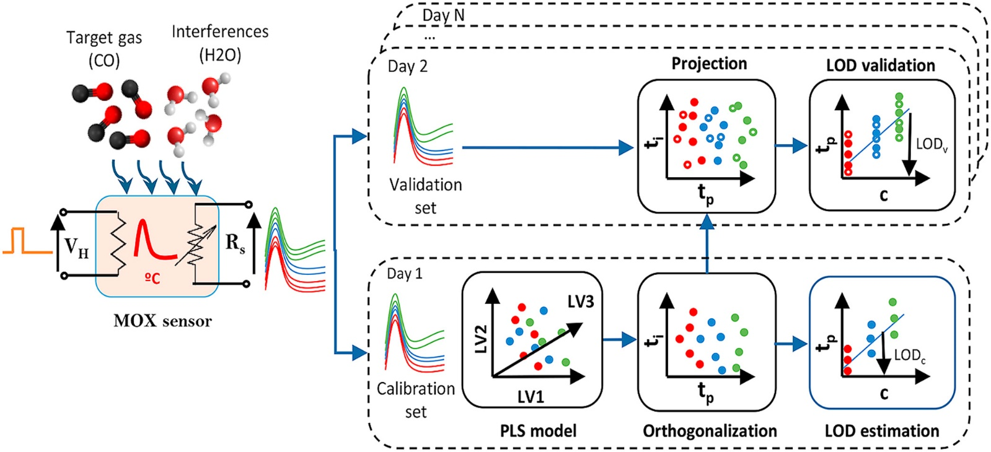
Introduction
Chemical detection platform composed of 14 temperature-modulated metal oxide semiconductor (MOX) gas sensors as in Figure 1.
The sensors are exposed to dynamic mixtures of carbon monoxide (CO) and humid synthetic air in a gas chamber.
Data collected with features based on input from 14 MOX sensors (MOhm), CO (ppm), Humidity (%r.h.), Temperature (ºC), Flow rate (mL/min), Heater voltage (V).
Step_1 is “Modelling Process” to develop a tool, which will provide predictions for the presence of CO (ppm), given features described above within collected data [e.g. validation is also part of first step].
Step_2 is “Model Results” and recommendations on commissioning, testing, periodic monitoring and calibrating the solution deployed.
Step_3 is “Process Architecture” for the actual deployment of the model.
Figure 1: Experiment Setup
[ Ref: https://www.sciencedirect.com/science/article/abs/pii/S0003267018303702 ]

Slide 3
Modelling Process
Figure 2: Machine Learning Logic Flow – Process Map

Slide 4
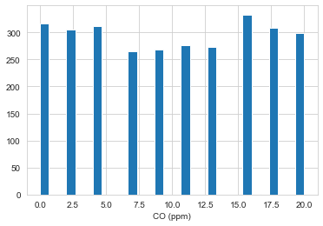
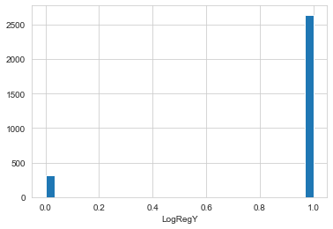
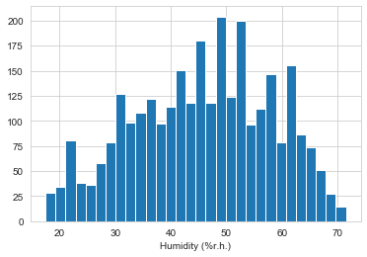
Modelling Process
Chart 1: CO (ppm) Histogram
Chart 2: Binary CO (ppm) Histogram
Chart 3: Humidity (%r.h.) Histogram
CO (ppm) is what we are trying to predict, also called Y in ML theory.
Vertical axis represents number of observations corresponding to the particular horizontal axis CO values.
Has got uniform distribution, not normally distributed.
CO (ppm) is converted into binary Y, if CO >0 then LogRegY=1, else LogRegY=0.
Histogram indicates around 90% of Y=1.
Humidity distribution resembles normal distribution.
Normal distribution found in nature and generally indicates a natural random input.
Though left tail shows slight thickness.
Figure 3: Exploratory Data Analysis Flow

Slide 5
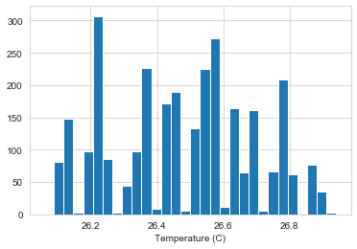
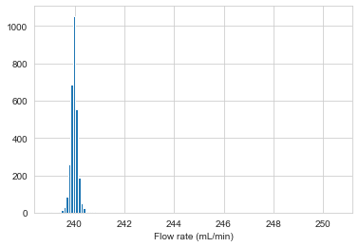
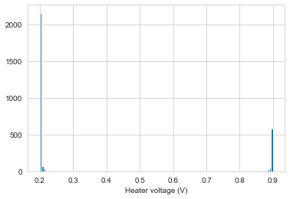
Modelling Process
Chart 4: Temperature (C) Histogram
Chart 5: Flow rate (mL/min) Histogram
Chart 6: Heater voltage (V) Histogram
Temperature input resembles not random.
Vertical axis represents number of observations and temperature range is around 26C ± 1.
Since most model algorithms assume natural random distribution [e.g. Normal], this variable may not be a good model feature candidate.
Flow rate displays huge skewness to the right [can not be seen in the plot, but have ranges around 250 mL/min].
In modelling process, outliers [which creates skewness] generally neglected or transformed [Cap and flooring].
Voltage not random and shows bi-modal [double peak or two waves] behaviour.
This may be a good un-supervised cluster feature [e.g. used as a filter to separate two experiments or data samples].
We can still throw into our ML algorithms, which will automatically eliminate if not predictive.
Figure 3: Exploratory Data Analysis Flow

Slide 6
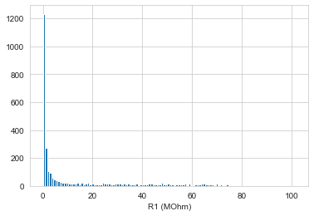
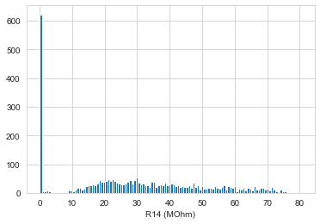
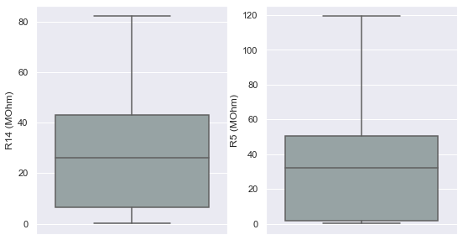
Modelling Process
Chart 7: R1 (MOhm) Histogram
Chart 8: R14 (Mohm) Histogram
Chart 9: R14 vs R5 Boxplot
R1 skewed to right with min value 0 and gradually increasing.
Vertical axis represents number of observations
Still a long tail and represent un-natural distribution here.
R1 has lots of 0 set.
But excluding 0 values, it may process a good predictive behaviour since as the rest of the part of the distribution behaves slightly Normal.
Boxplots displayed here. Middle horizontal line is mode [50th percentile].
R5 has main values concentrated around 0-50 whereas R14 is near 30.
Boxplots also show min/max [hence range]. We can identify R14 max is around 85 vs R5 max around 120 Mohm
Check Appendix for remaining feature plots
Figure 3: Exploratory Data Analysis Flow

Slide 7
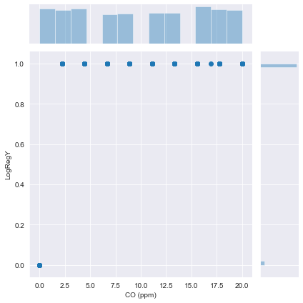
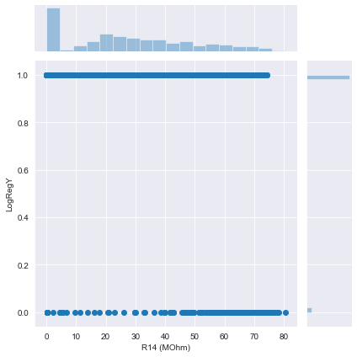
Modelling Process
Chart 10: Pair plot CO(ppm) vs LogRegY
Chart 11: Pair plot R14 (MOhm) vs LogRegY
This is to represent how to read the plot. LogRegY is derived directly from CO, so when LogRegY=1, it corresponds to scatter points of CO > 0 [This was how we defined it].
Big chart box is scatters, small 2 chart boxes are histograms like previous slides
As R14 increases, scatters of LogRegY=0 increases too, so there is definitely a correlation here [More on to this in coming slides].
Figure 3: Exploratory Data Analysis Flow

Slide 8
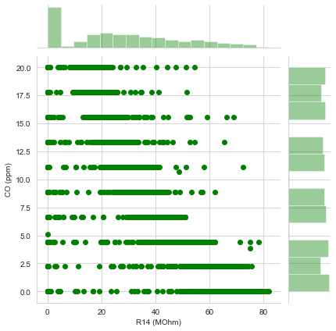
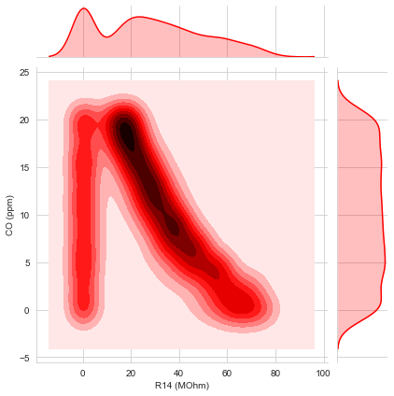
Modelling Process
Chart 12: Pair plot R14(MOhm) vs CO (ppm)
Chart 13: Pair plot R14 (MOhm) vs CO(ppm)
As R14 values increase, CO displays a noticeable increase in scatters, again an indication of correlation [more on this on next slides].
Just another type of representation of the correlation where bolder red indicates more scatter points. Clearly seen the linear correlation here.
Figure 3: Exploratory Data Analysis Flow

Slide 9
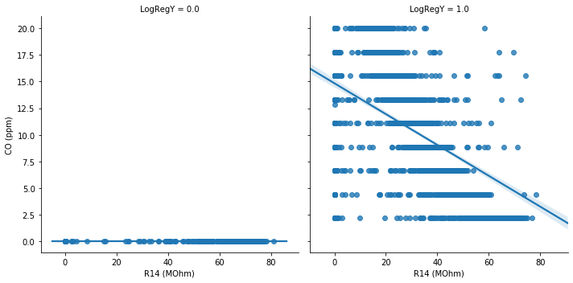
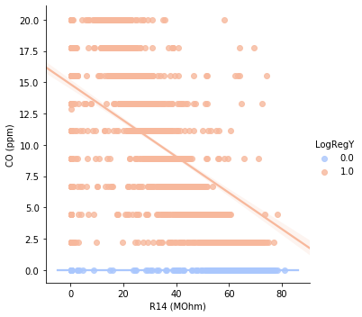
Modelling Process
Chart 14: Regression fit plot, R14(MOhm) vs CO (ppm) vs LogRegY
Chart 15: Hue Regression fit plot, R14 (MOhm) vs CO(ppm) vs LogRegY
Left plot indicates the population where LegRegY=0, correlation between R14(MOhm) vs CO (ppm). Notice the increase in number of scatters, when the value of the R14 increases.
Right plot indicates the population where LogRegY=1 (or CO(ppm)>0). There is clear regression fit line here. The steeper the slope, higher the correlation. The fit line indicates the best fit behaviour.
This is just explaining the same story as Chart 14 just by hue effect into one single chart, included here to create more visual understanding of this behaviour.
Figure 3: Exploratory Data Analysis Flow

Slide 10
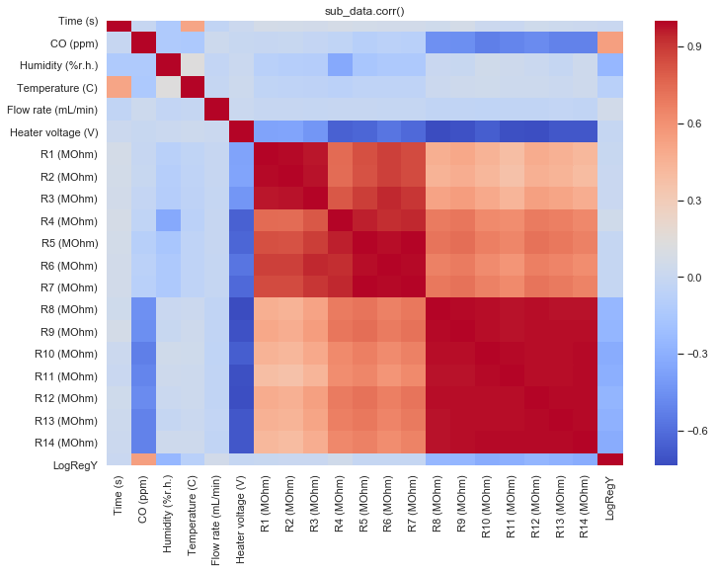
Modelling Process
In a nutshell, this plot represents the intercorrelation of all features between each other. From R8 to R14 there is a cluster of multi-collinearity [means they are behaving similar]
R1 to R7 also have multi collinearity.
Darker red or blue represents strong negative or positive correlation.
We are looking at darker colours regardless of negative or positive direction, these will have information for the model.
Diagonal line is always dark, as it is equal to 1, indicating correlation within the same feature.
Figure 3: Exploratory Data Analysis Flow
Chart 16: Heat map representing all features and their inter correlation

Slide 11
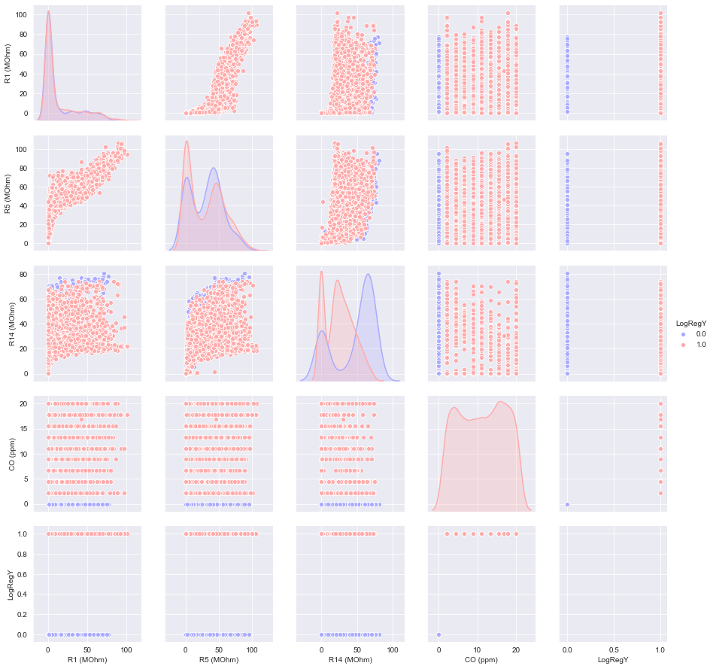
Modelling Process
This is a pair plot with hue based on LogRegY, where blue is scatters where LogRegY=0 and red is where LogRegY=1 [See legend].
Diagonal plots represents the histogram lines where blue area/line represents LogRegY=0 distribution and red is for LogRegY=1.
R1, R5 and R14 is selected to go into the model. This seemed like the most intuitive selection based on the visual EDA and steps up to now.
From previous Chart 16, R1,R5 and R14 seemed to have a high correlation between rest of the features, so having the remaining features does not seem like adding value to the descriptive and predictive power of the model.
Voltage is bi-model, temperature seems like forced (not dispersed enough), time is an input so should not be considered. Flow rate is also not considered as not showing enough correlation.
Humidity has good natural distribution, has some correlation, but we will still not considered it as it is assumed to be a random input. Aim of this process is to understand and predict the behaviour of the CO based on R1-R14 sensors.
Figure 3: Exploratory Data Analysis Flow
Chart 17: Hue Pair plot between final selected features

Slide 12
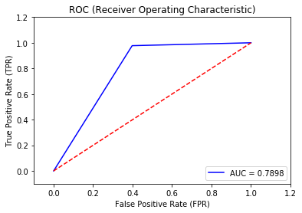
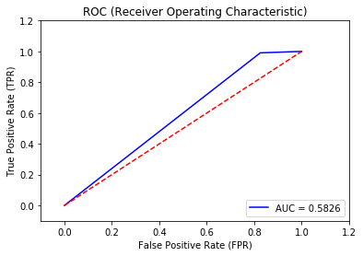
Modelling Process
Chart 18: Log_1 Roc_AUC Plot
Chart 19: Log_1 Roc_AUC Plot
Model | TN | FN | TP | FP | Recall | Accuracy | GINI
Log_1 | 56 | 37 | 20 | 863 | 0.60 | 0.94 | 0.58
Log_2 | 22 | 104 | 8 | 842 | 0.17 | 0.89 | 0.17
Log_1 indicates the model with all features included. Log_2 indicates model with only R1,R5 and R14 included. We can see clearly, Log_2 is performing poorly here. GINI, Accuracy and Recall are all lower.
TN is True Positive, FN False Negative, TP True Positive, FP False Positive [Refer Appendix for more info on this]. In short, we are trying to increase TN and TP and decrease FN and FP.
Our LogRegY rate is around 90% [See previous slides showing histograms], so even a random guess would provide near 90% accuracy, so anything around 0.9 accuracy is a poorly performing model. Our Log_2 is a very poor model in this case.
Figure 4: Performance Testing Flow

Slide 13


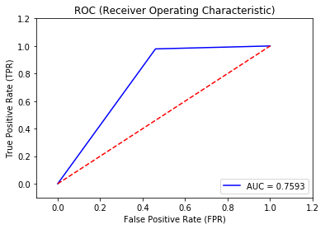
Modelling Process
Chart 20: SVC_1 Roc_AUC Plot
Chart 21: SVC_Grid_1 Roc_AUC Plot
Chart 22: SVC_Grid_2 Roc_AUC Plot
Model | TN | FN | TP | FP | Recall | Accuracy | GINI
SVC_2 | 9 | 84 | 1 | 882 | 0.10 | 0.91 | 0.10
SVC_Grid_1 | 56 | 37 | 19 | 864 | 0.60 | 0.94 | 0.58
SVC_Grid_2 | 68 | 58 | 18 | 832 | 0.54 | 0.92 | 0.52
SVC_2 Support Vector Model with R1,R5 and R14 included with no GridSearch, SVC_Grid_1 means all features included with GridSearch optimisation. We didn’t tabulate the run results for SVC_1 because it gave zero GINI.
GINI, Accuracy and Recall are ok in SVC_Grid_1 and SVC_Grid_2. And incredible result by adding GridSearch especially to SVC_1 where GINI increase from nothing to 0.52. SVC_Grid_2 is significant improvement as only with 3 features, we were able to describe almost all of the prediction power of Log_1 with all features included [see previous slide].
Figure 4: Performance Testing Flow

Slide 14
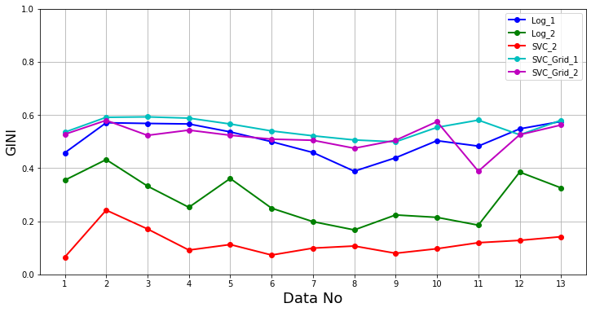
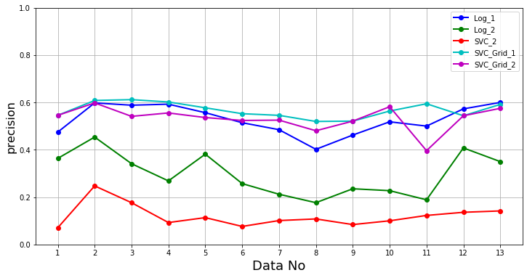
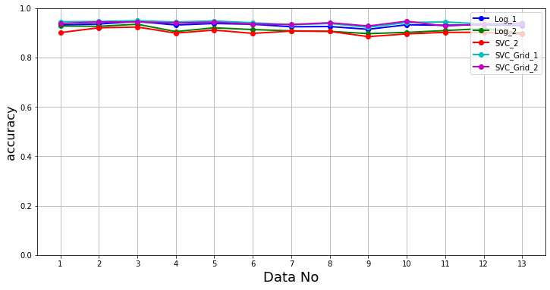
Model Results
We have designed a dashboard as such, where can be compared 5 model selection performance based on time/date dependent data.
We have utilized all of the available 13 data sets, so Data number is indicated in the horizontal axis [See Appendix for list of data corresponding date].
We have come to a come to a conclusion that either full feature Log_1 or SVC_Grid_2 is the best option at this stage [This is for demonstration only, there are more to consider into this – will be explained in the meeting].
The reason for our conclusion is although all models shows stability on results [which is a reflection of data consistency], Log_1, SVC_Grid models showed superiority over other options. SVC_Grid_2 performed good considering with only 3 features which reduces complexity and eases implementation & monitoring.
Next steps going forward could be possible to check other supervised algorithms e.g. [Though listed below tend to work better for nonlinear features, still worth checking]
These could be XGBoost, Random Forrest.
We can try un-supervised classification(s) to start with and model different classifications separately e.g. If we have two voltage input(s) - two waves or bi-modal input, this may suggest we may have some classification(s), where we can use algo’s like:
K means, PCA: Principle Component Analysis, to idenfity these classification(s), cluster(s).
If we have resource time, we can check Deep Learning Algorithms like Neural networks.
These could be, perceptron models with Tensorflow & Keras, Backpropagation and activation function optimisation and so on.
Figure 5: Model Automation Flow
Chart 23: GINI, Recall, Accuracy - Combined Plot

Slide 15
Process Architecture
Cloud and General System Considerations include:
Frequency of data refresh, lag/real time transfer, speed, security, ML analytics type e.g. cloud vs server.
This is high level Industrial IoT Process Architecture. For our solution, we receive data from SENSORS and follow the process.
ML Model is part of Cloud Analytics.
SENSORS are providing the required data.
[see Figure 1]
ERP: Enterprise Requirements Planning
MES: Manufacturing Execution System
CNC: Computer Numerical Control
PLC: Programmable Logic Controller
DCS: Distributed Control System
REST: Representations State Transfer
RESTful: Web services that conform to the REST architectural style
OPC: Open Platform Communication
OPC-UA: OPC Unified Architecture
OPC-DA: OPC Data Access
MQTT: Message Queuing Telemetry Transport
CoAP: Constrained Application Protocol
IoT: Internet of Things
Figure 6: Process Architecture - Flow Diagrams

